Slide 1



Twitter Sentiment Analysis
Submitted by: Anmol Baunthiyal
Registration Number: 11908907

Slide 2
contents
INTRODUCTION
TYPES OF SENTIMENT ANALYSIS
USES OF SENTIMENT ANALYSIS
DATASET USED
CODE

Slide 3

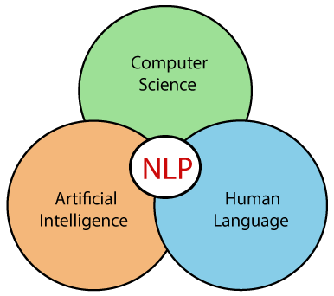
Introduction to sentiment analysis
Sentiment analysis is a type of technique that determines whether data is positive, negative, or neutral. Sentiment analysis on textual data is frequently used to assist businesses in monitoring brand and product sentiment in customer feedback and understanding customer needs.

Slide 4
Types of sentiment analysis
There are many types of sentiment analysis some of them which are majorly used are:
Emotion Detection Sentiment Analysis
Aspect based Sentiment Analysis
Fine Grained Sentiment Analysis

Slide 5




USES OF SENTIMENT ANALYSIS
SOCIAL MEDIA MONITORING
CUSTOMER SUPPORT
PRODUCT ANALYSIS
COMPETITOR ANALYSIS
BRAND MONITORING AND
REPUTATION MANAGEMENT

Slide 6

TWITTER SENTIMENT ANALYSIS
Twitter sentiment analysis allows you to keep track of what's being said about your product or service on twitter, and can help you detect angry customers or negative mentions before they escalate. At the same time, Twitter sentiment analysis can provide valuable insights that drive decisions.

Slide 7
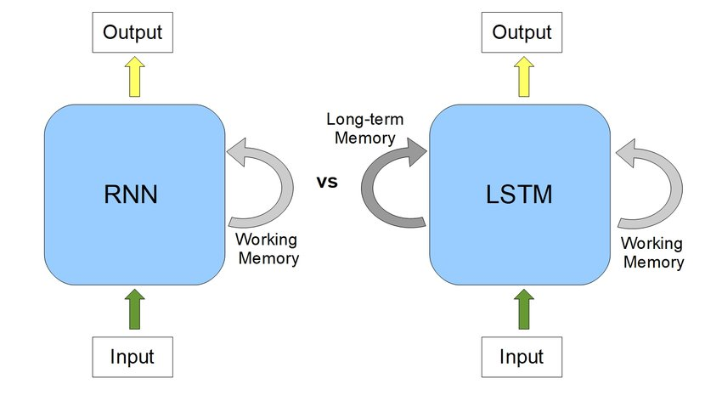

LSTM (Long short term Memory)
Unlike RNNs which remembers the data for a very short period of time LSTM keeps track of data for both long term and short term making it suitable for text based classification where the input data is long.
LSTM keeps track of all the important keywords it encounters during the processing the input and predicts the further output accordingly.

Slide 8
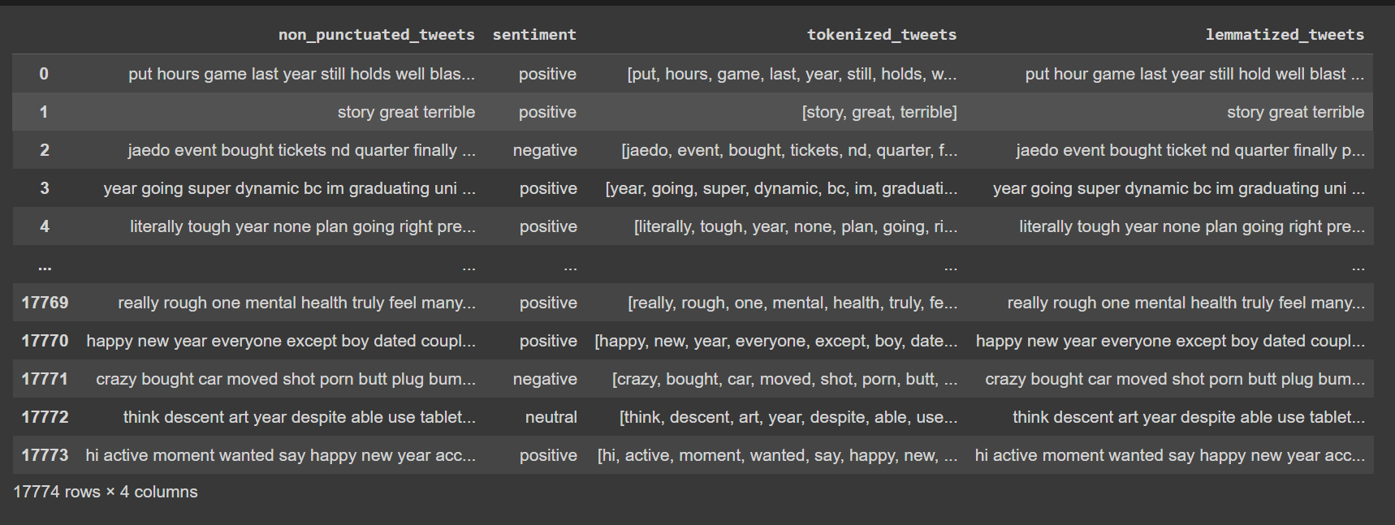
Dataset used

Slide 9
Code
Google Colab

